Slide 1

CHICAGO WEST NILE VIRUS CONTROL PLAN
WESLEY
RUSSELL
SATHYA
BOON JUN

Slide 2



INTRODUCTION
WHAT IS WEST NILE VIRUS (WNV)
1 IN 5
Leading cause of mosquito borne disease in USA
Summer
through fall
No vaccine,
No medications
Developed symptoms

Slide 3

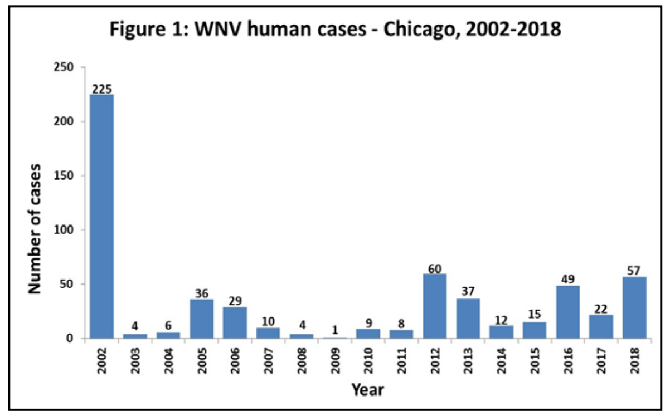
INTRODUCTION
CHICAGO
First Wnv case: 225 in 2002
Implemented city wide surveillance & mosquito control measures
Continues to have one of the most robust mosquito control program in the US
Source: Chicago Department of Public Health (CDPH)

Slide 4
PROBLEM STATEMENT
Predicting The Presence Of Wnv For Coming Mosquito Season On Weekly Basis
&
Providing Effective Spray Strategy For City Of Chicago

Slide 5
DATASETS
DATE
TRAIN
ADDRESS
TEST
SPECIES
10,506
BLOCK
116,293
STREET
Observations
TRAP
Observations
2007,2009,2011,2013
ADDRESS NUM & STREET
2008,2010,2012,2014
LATITUDE
NUM MOSQUITO
LONGITUDE
ADDRESS ACCURACY
WNV PRESENT

Slide 6
DATASETS
WEATHER
SPRAY
2007 - 2014
14,835
NOAA weather data
Observations
22 weather features
2011 (2 dates)
2013 (July – Sep)
2 Stations
1) CHICAGO O'HARE INTERNATIONAL AIRPORT
Spray effort data by Chicago
government
2) CHICAGO MIDWAY INTL ARPT

Slide 7






WORKFLOW
Data
Cleaning
Analysis
Data
Merging
Feature
Engineering
Modelling
Cost-Benefit
Analysis

Slide 8


CLEANING
TRAIN & TEST
Relatively clean with no null values
Train
Mosquitos count capped at 50 for each date, trap, species and Wnv present
Sum up all mosquitos of same date, trap, species and Wnv present, drop duplicate
Num
Mosquito
Num
Mosquito

Slide 9



ANALYSIS
TRAIN
Wnv Present = 1
5.3%
Wnv Present = 0
94.7%

Slide 10
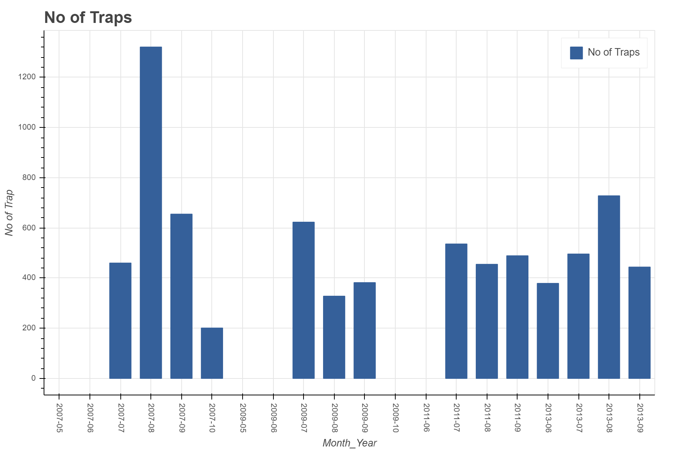
ANALYSIS
TRAIN

Slide 11
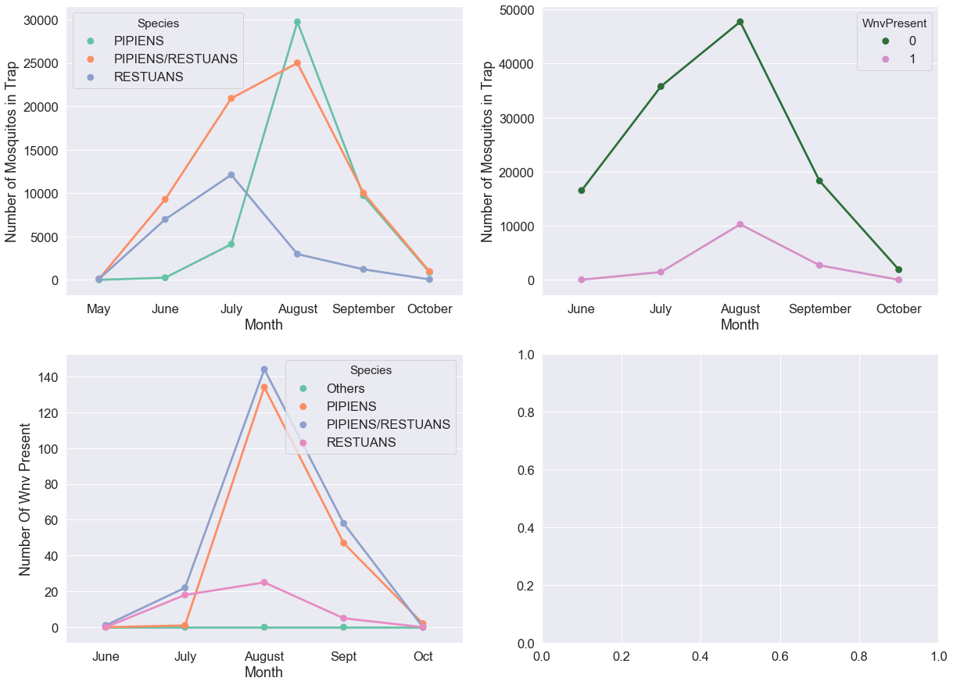
ANALYSIS
TRAIN
Most number of Wnv positive mosquitos in August
Most number of mosquitos in August for species Pipens & Pipens/Restuans
Pipens & Pipens/Restuans seem to be the main contributors

Slide 12
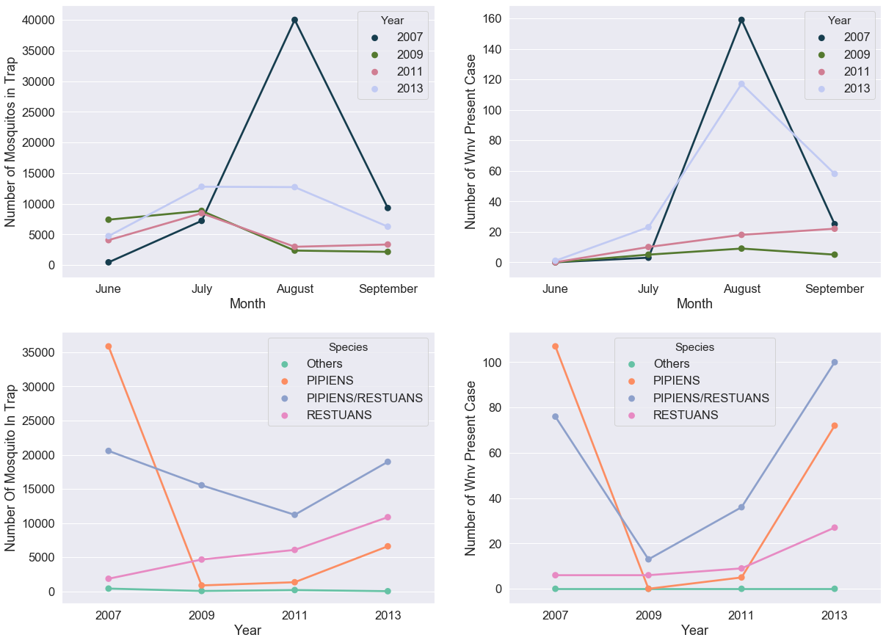
ANALYSIS
TRAIN
Sharp drop in no. of Wnv Present cases between 2007 to 2009
Sharp increase between 2011 and 2013
Sharp drop in PIPENS mosquito from 2007 to 2009 and increase from 2011 to 2013
PIPENS mosquito seems to be a major factor affecting whether Wnv is present

Slide 13




CLEANING
WEATHER
Data had no null values there were many missing values and traces which were labelled M and T
Making references to best fill missing data (e.g. WetBulb, StnPressure)
Dropped columns with low variance or when there is no logical way to input values (e.g. SnowFall, Water1)

Slide 14
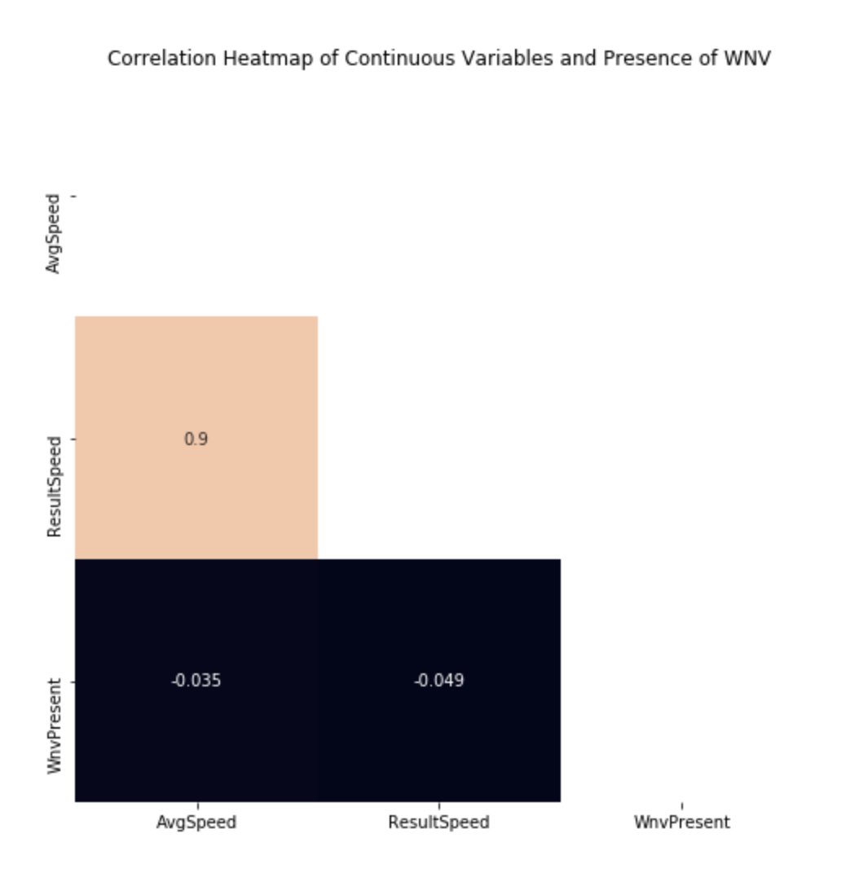
ANALYSIS
WEATHER
Removing Collinear Terms
AvgSpeed | 0.034605
ResultSpeed | 0.048893

Slide 15
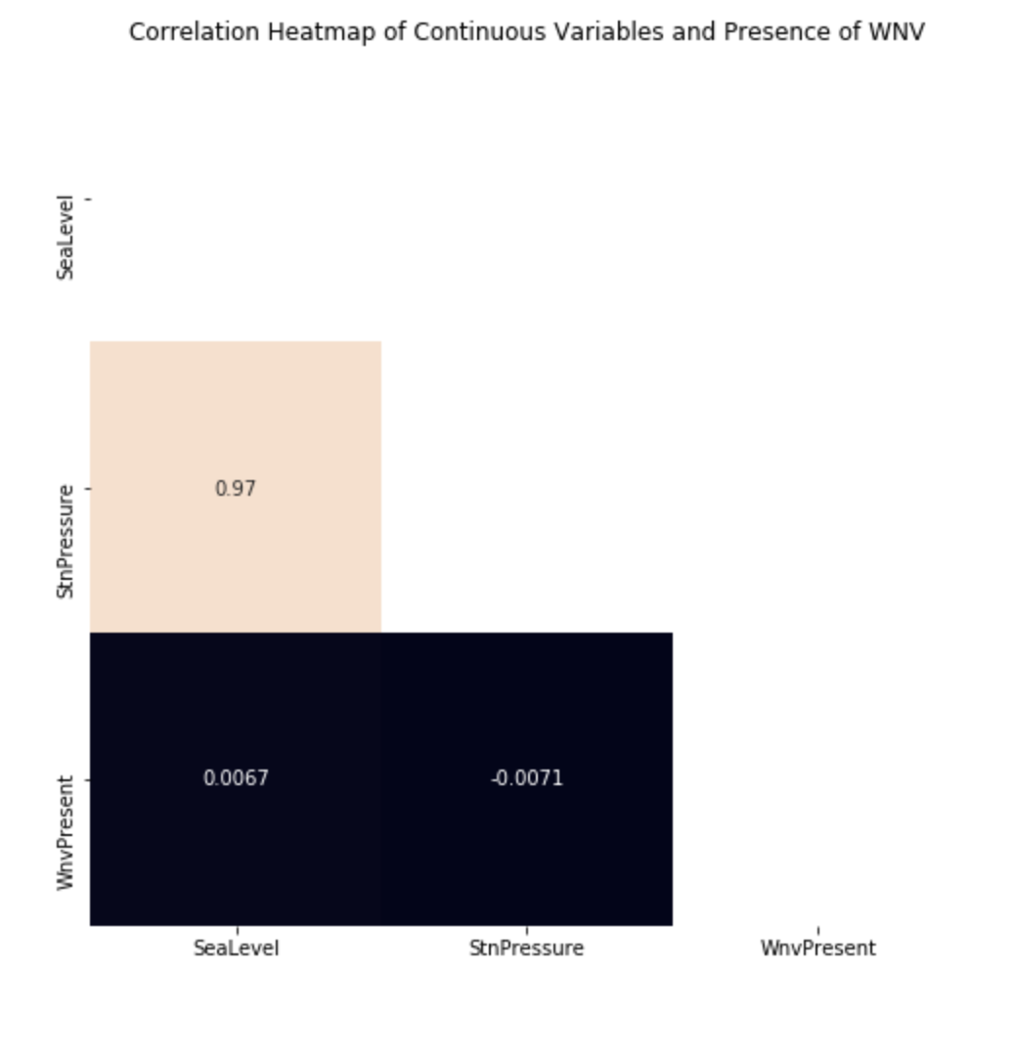
ANALYSIS
WEATHER
Removing Collinear Terms
SeaLevel | 0.006738
StnPressure | 0.007149

Slide 16
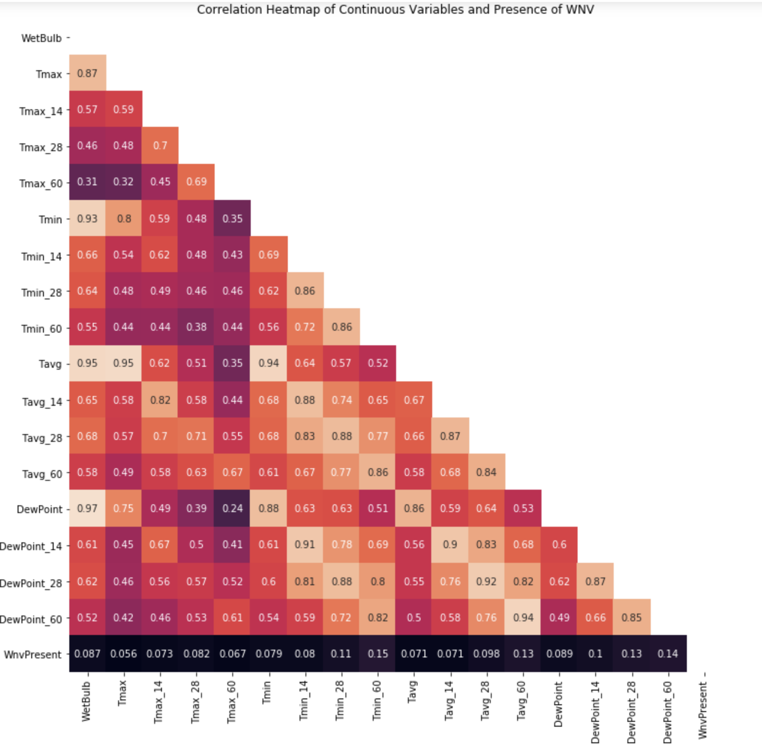
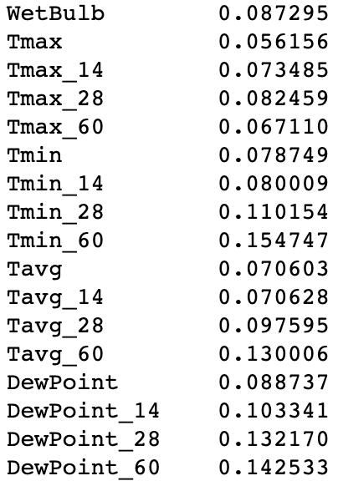
ANALYSIS
WEATHER
Removing Collinear Terms

Slide 17
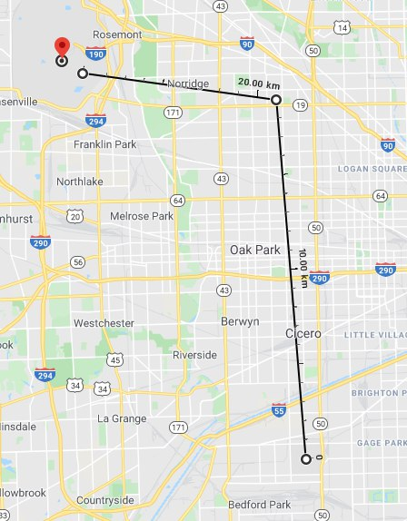

MERGING
WEATHER + TRAIN/TEST
Station 1
Two main weather stations:
Station 1: Chicago O'Hare International Airport
Station 2: Chicago Midway International Airport
Calculate displacement to the weather stations and take information from nearest station when merging to train/test data.
Station 2

Slide 18




ENGINEERING
Identify main locations with highest WnvPresent
Calculate the distance from these locations to the rest of the train/test data
Get rolling mean of different periods for temperature, dewpoint and precipitation

Slide 19

ENGINEERING
SMOTE
Wnv Present = 0
50%
Wnv Present = 1
50%

Slide 20

MODELLING
RANDOM FOREST
CLASSIFIER
SUPPORT VECTOR
CLASSIFIER
0.75095
0.70679

Slide 21
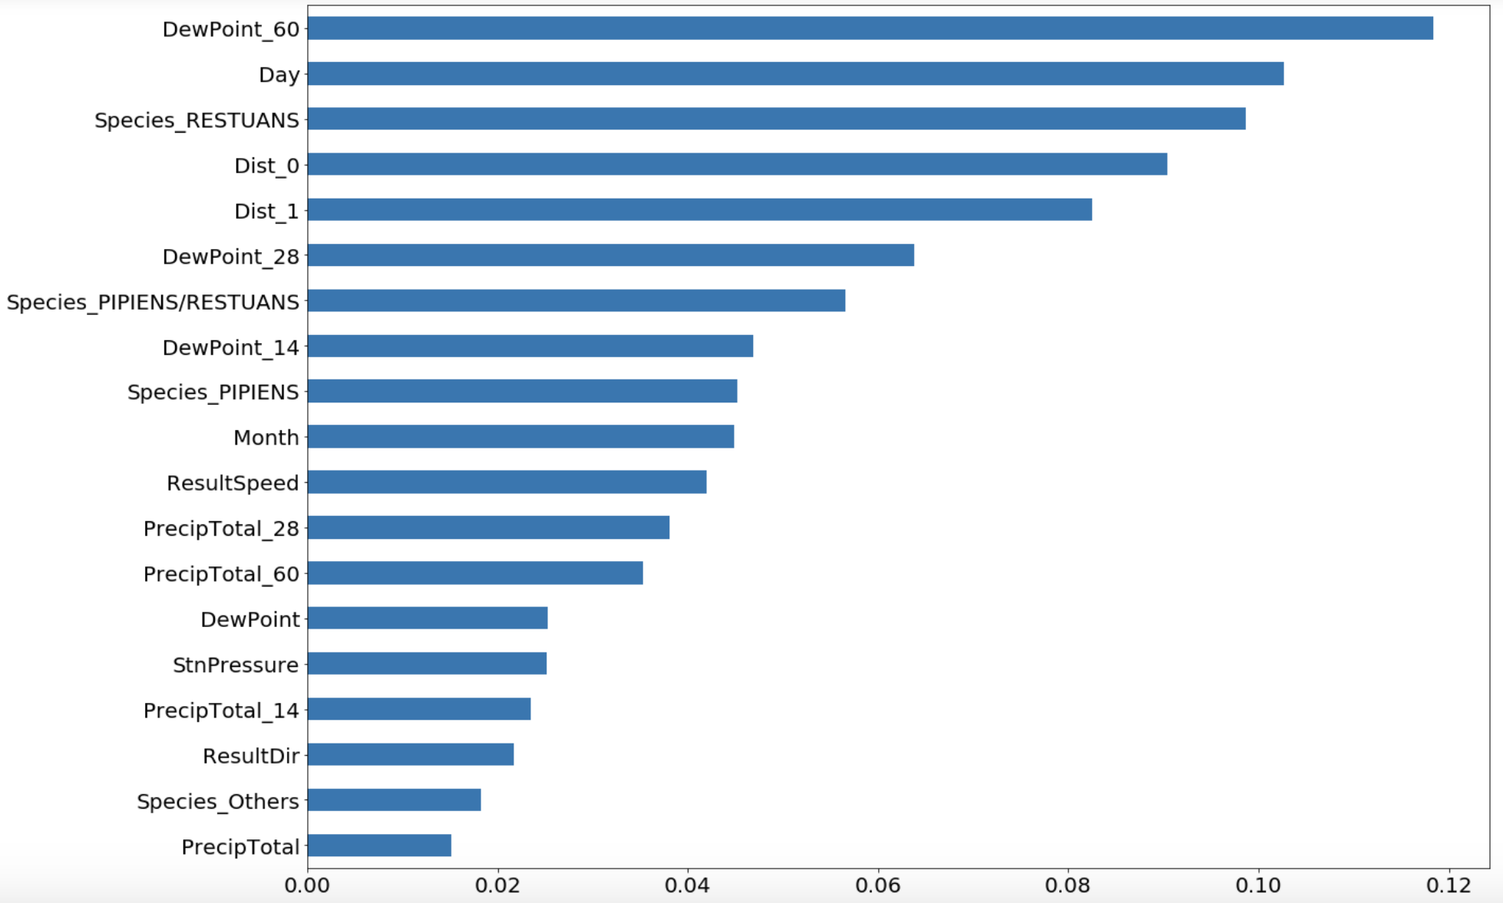
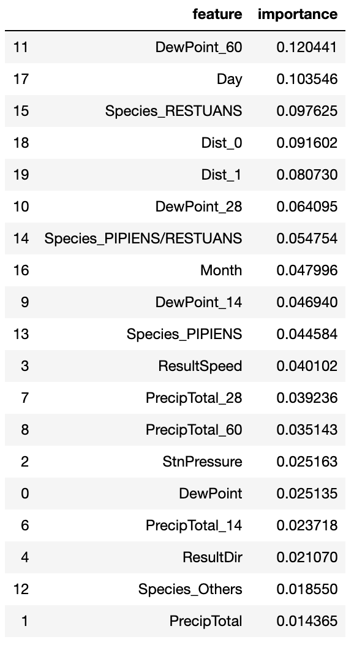
MODELLING

Slide 22

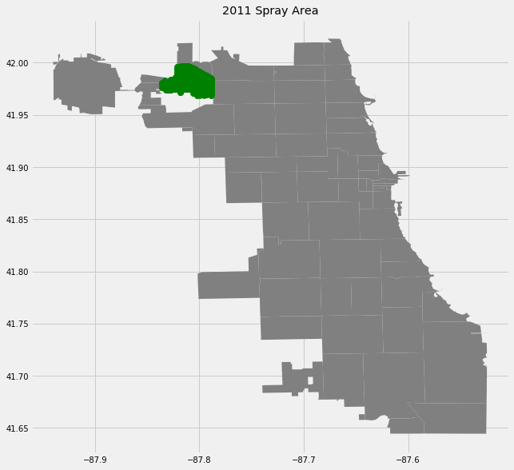
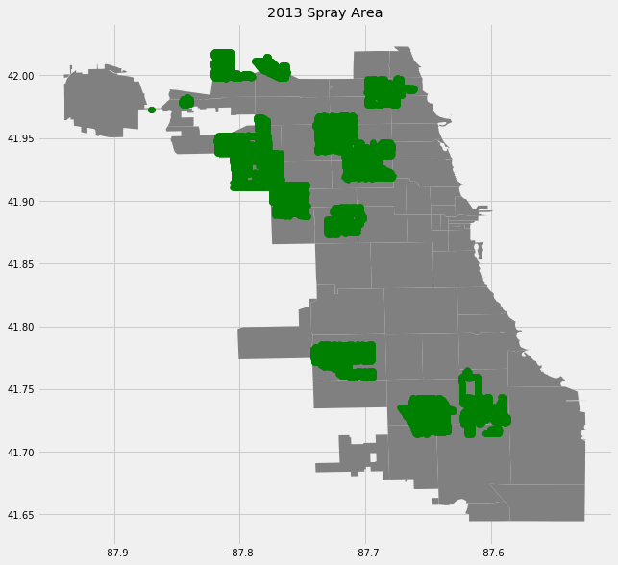

COST ANALYSIS
SPRAY DATA
2011 data limited
Analyse only on 2013

Slide 23
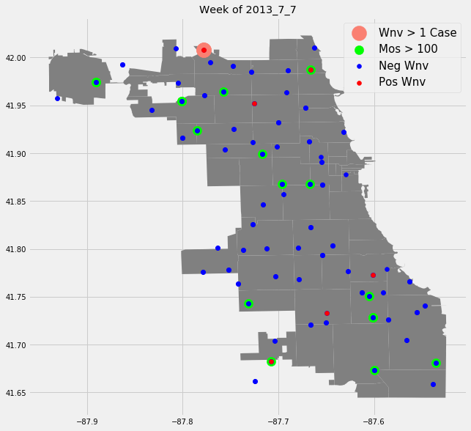
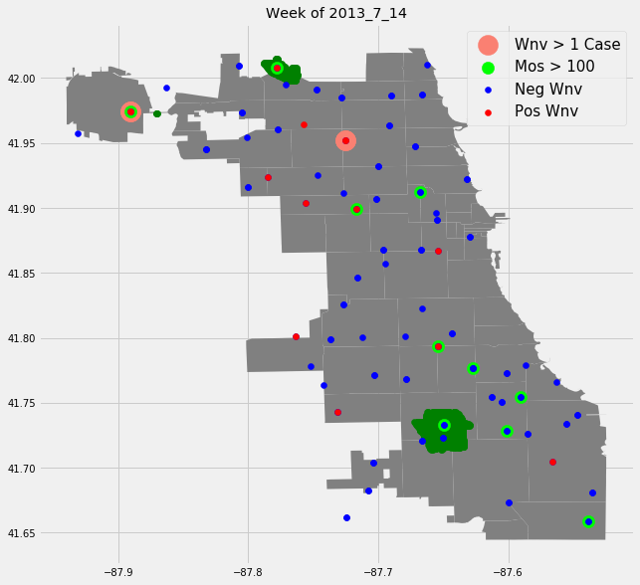
COST ANALYSIS
2013 SPRAY DATA

Slide 24
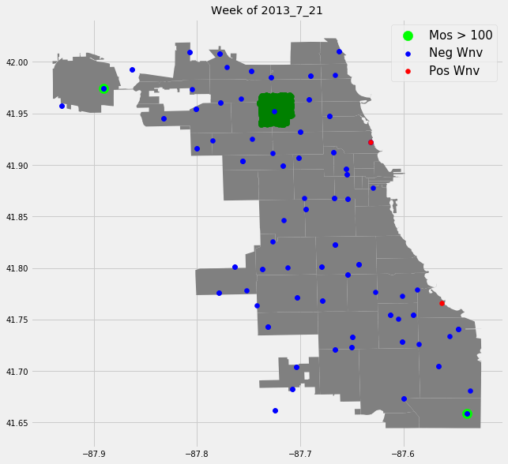
COST ANALYSIS
2013 SPRAY DATA

Slide 25
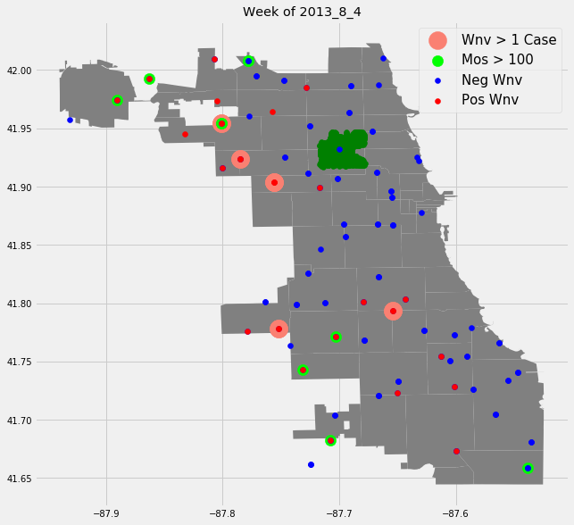
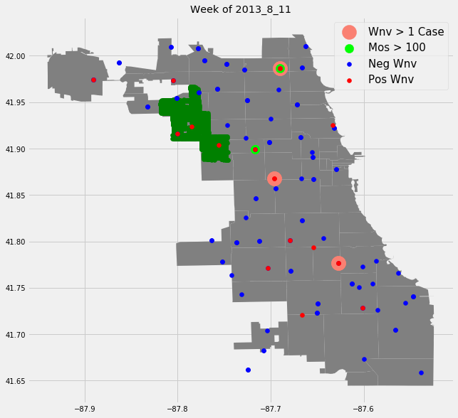
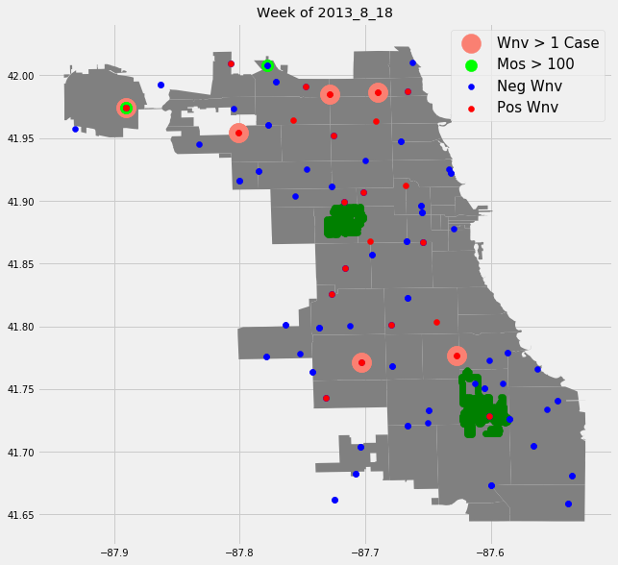
COST ANALYSIS
2013 SPRAY DATA

Slide 26
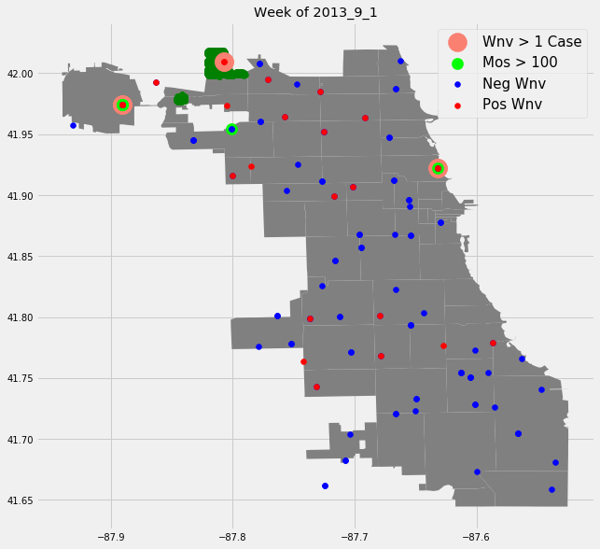
COST ANALYSIS
2013 SPRAY DATA

Slide 27
COST ANALYSIS
2013 SPRAY DATA
Spraying worked but with short term effect
Sprayed areas often lagged by at least 1 week
Year | Total Spray Count | Total Mosquitos with Wnv +Ve | No. of Wnv Human case* | Ratio of Wnv Mos : Human
2011 | 1668 | 50 | 8 | 6.25
2013 | 12626 | 199 | 37 | 5.38
Differences (2013/2011) | 7.57 | 3.98 | 4.63 | 0.86
*Source: Chicago Department of Public Health (CDPH)

Slide 28

COST ANALYSIS
COST ESTIMATION
12626 spray to eliminate 14 traps with +ve Wnv
12626/14 = 902 spray/+ve Wnv trap
Average price per spray: USD 100
Visually inspect 10 weeks plot or calculate no. of trap require to spray if option is chosen in 2013

Slide 29
COST ANALYSIS
RECOMMENDATIONS
Total: 199 Traps
Total cost:
199 * 902 * 100 = $17,946,957
OPTION 1

Slide 30
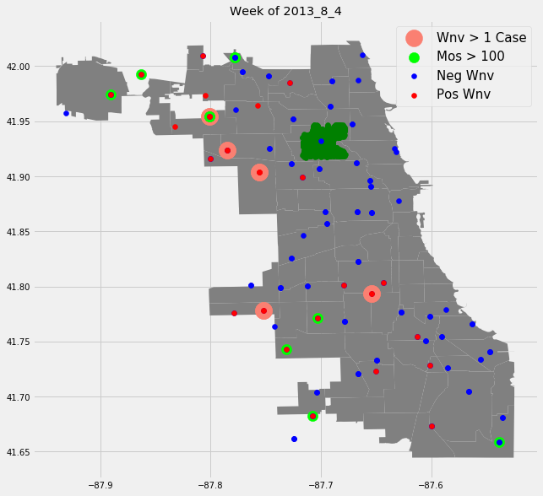
COST ANALYSIS
RECOMMENDATIONS
4
OPTION 2
5
2
3
1
Total: 41 Traps
Total cost:
41 * 902 * 100 = $3,697,614
9
10
7
8
6

Slide 31
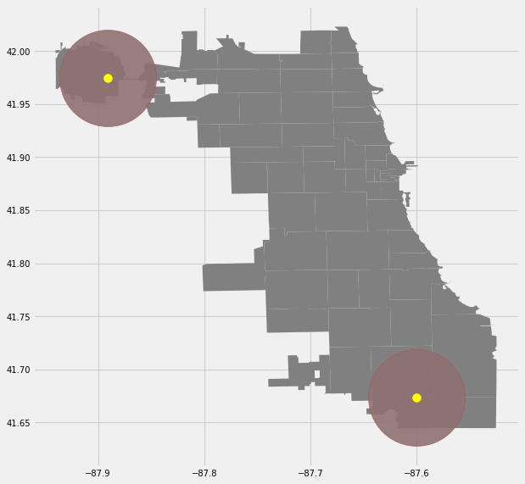
COST ANALYSIS
RECOMMENDATIONS
OPTION 3
Total: 23 Traps
Total cost:
23 * 902 * 100 = $2,074,271

Slide 32
COST ANALYSIS
RECOMMENDATIONS
Estimated actual 2013 spending: $1,262,600
 | Option 1 | Option 2 | Option 3 | Option 4
Method | Spray all Wnv Positive Areas | Spray based on community areas | Spray based on distance from 2 key points | Release genetically modified mosquitos
Pros | Reduce Wnv +ve mosquito can be dramatically | Reduce Wnv +ve mosquitos in high risk area Cost saving | Focus effort in 2 specific areas Spray on lesser areas | Long term fixed solution
Cons | Costly | Missing out some Wnv +ve traps | Missing out some Wnv +ve traps | Require significant R&D investment cost & time to implement
Cost | $17,946,957 | $3,697,614 | $2,074,271 | $3,599,880

Slide 33



SUMMARY
Random Forest Classifier
0.75095
Spray Recommendations
4 Options
More Info
No. Mosquito in test
No. of Wnv human case & area
More spray data

Slide 34
THANK YOU

